Slide 1
Reproducible reports
Fani Apostolidou Kiouti

Slide 2
Principles of reproducibility
Reproducible research is considered nowadays a prerequisite for transparent science. To ensure your research is reproducible, three things must be considered:
Data availability
System state at the moment of analysis
All the code needed; both data cleaning and analytic
To document your system state your can use metadata packages like {sessioninfo} and {packrat}.
sessioninfo::session_info()

Slide 3
Markdown and YAML
Two markup languages
YAML is used to serialize data across all languages
Markdown can create reproducible, dynamic reports

Slide 4
Output format and options
To construct an R file with the ability to compile into a document with {rmarkdown} the header of the document should be a YAML object, contained into three dashes ---.
title:, author: and date: may be sequential and do not need indentation
output: is defined with 2 character indentation for the format and 4 for their options

Slide 5
Output format and options (cont.)
--- output: html_document: toc: TRUE ---
html html_document
pdf pdf_document
Microsoft Word word_document
OpenDocument Text odt_document
Microsoft Powerpoint powerpoin_presentation
ioslides HTML ioslides_presentation

Slide 6
References and citations
link-citations: enables the use of DOI numbers in-line with the text [@doi:...]
bibliography: point to the file containing the citations
.bib format; exported from all reference managers (Zotero, EndNote, Jabref, Mendeley) or from the databases (PubMed, Scopus)
--- output: html_document: link-citations: yes bibliography: references.bib ---

Slide 7
Table of contents
A table of contents is created according to the text’s headers definitions.
# first level header
## subheading
and so forth
A floating table of contents is on the left of the main text and follows the advance to the bottom.
--- output: html_document: toc: yes toc_float: yes ---

Slide 8
Text
Within the free text, one can insert lines and paragraphs, lists, urls, code, equations and bold or italic characters.
A new paragraph is inserted when a line ends with two spaces .
Any phrase contained into a single pair of * will be printed in italics; when it is contained in a double pair of ** will be printed in bold.
Headings are sequentially syntaxed with #; one # for the main heading, ## for the first order subheading, ### for a second order subheading and so on.

Slide 9
Urls
There are three formats to insert a url in the text:
<www.link>
[phrase](www.link)
[phrase][id] with the addition of the element [id]: www.url.link at the end of the document.

Slide 10
Lists
Lists may be ordered or unordered. Ordered list are defined with numbers and unordered with dashes.
The syntax
1. first - item 2. second
will return
first
item
second

Slide 11
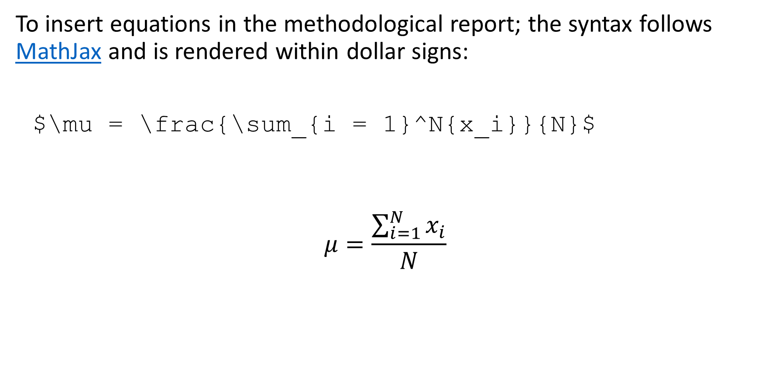
Equations
To insert equations in the methodological report; the syntax follows MathJax and is rendered within dollar signs:
$\mu = \frac{\sum_{i = 1}^N{x_i}}{N}$
$$μ=\frac{\sum_{i=1}^{N}{x_{i}}}{N}$$

Slide 12
Inline code
Small pieces of code in line with the text; for example a value extracted from an object.
Syntax `rfunction` and the command will be evaluated; only the result will be displayed in text.

Slide 13
Code chunks
The integration of text and executable code in one single document; to insert code, in various languages, first and foremost use the code chunk syntax:
```{r}
```
Many other languages are supported in {knitr}
Having set the language one can name the code chunk with one a white space after the language name.
```{r current chunk}

Slide 14
Code chunks
Useful options include echo, error, eval, message, warning, comment and figure options.
All options are logical except from the figure options.
```{r current chunk, warning = F, message = F}
will display code and results without messages
```{r current chunk, eval = F}
will display only code and
```{r current chunk, echo = F}
will display only the result

Slide 15
Tables
Tables from data frames are either inserted from functions such as kable() or from packages like kableExtra, gt in combination with gtsummary.
However, there is a syntax that facilitates quick table construction and uses dashes and vertical lines.
Col1|Col2|Col3 ----|----|--- val1|val2|val3 val4|val5|val6 val7|val8|val9
Vertical lines must only be aligned with the column headers line; the value lines may differ in length to accommodate their contents.

Slide 16
Object export
In general, if one wants to export a report to Word, they simply set {knitr} to knit to Word. Alternatively, one can use Rich Text Format:
as_rtf(object) -> name write_file(name, path)
All plots and figures created in the Console will be separately displayed in the graphics manager and can be exported from there to various formats, both vector and raster.
Datasets may be exported into Excel or CSV files. To export to Excel, the {xlsx} is used, there is a native function for CSV files.
xlsx::write.xlsx(data, file = "path/name.xlsx") write.csv(data, file = "path/name.csv")

